Slide 1
E-commerce Security and Payment
By: Dr. Ramesh Saini
Assistant Professor of
Computer Science Dept.
Copyright © 2010 Pearson Education, Inc.

Slide 2
Cyberwar:
Mutually Assured Destruction 2.0
Class Discussion
What is the difference between hacking and cyberwar?
Why has cyberwar become more potentially devastating in the past decade?
What percentage of computers have been compromised by stealth malware programs?
Will a political solution to MAD 2.0 be effective enough?

Slide 3
The E-commerce Security Environment
Overall size and losses of cybercrime unclear
  Reporting issues
2009 CSI survey: 49% of respondent firms detected security breach in last year
  Of those that shared numbers, average loss $288,000
Underground economy marketplace:
  Stolen information stored on underground economy servers

Slide 4
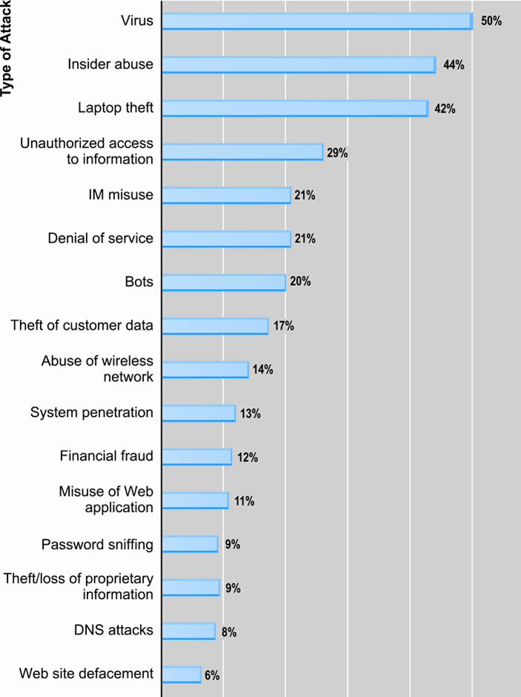
Types of Attacks Against Computer
Systems (Cybercrime)
SOURCE: Based on data from Computer Security Institute, 2009

Slide 5
What Is Good E-commerce Security?
To achieve highest degree of security
  New technologies
  Organizational policies and procedures
  Industry standards and government laws
Other factors
  Time value of money
  Cost of security vs. potential loss
  Security often breaks at weakest link

Slide 6
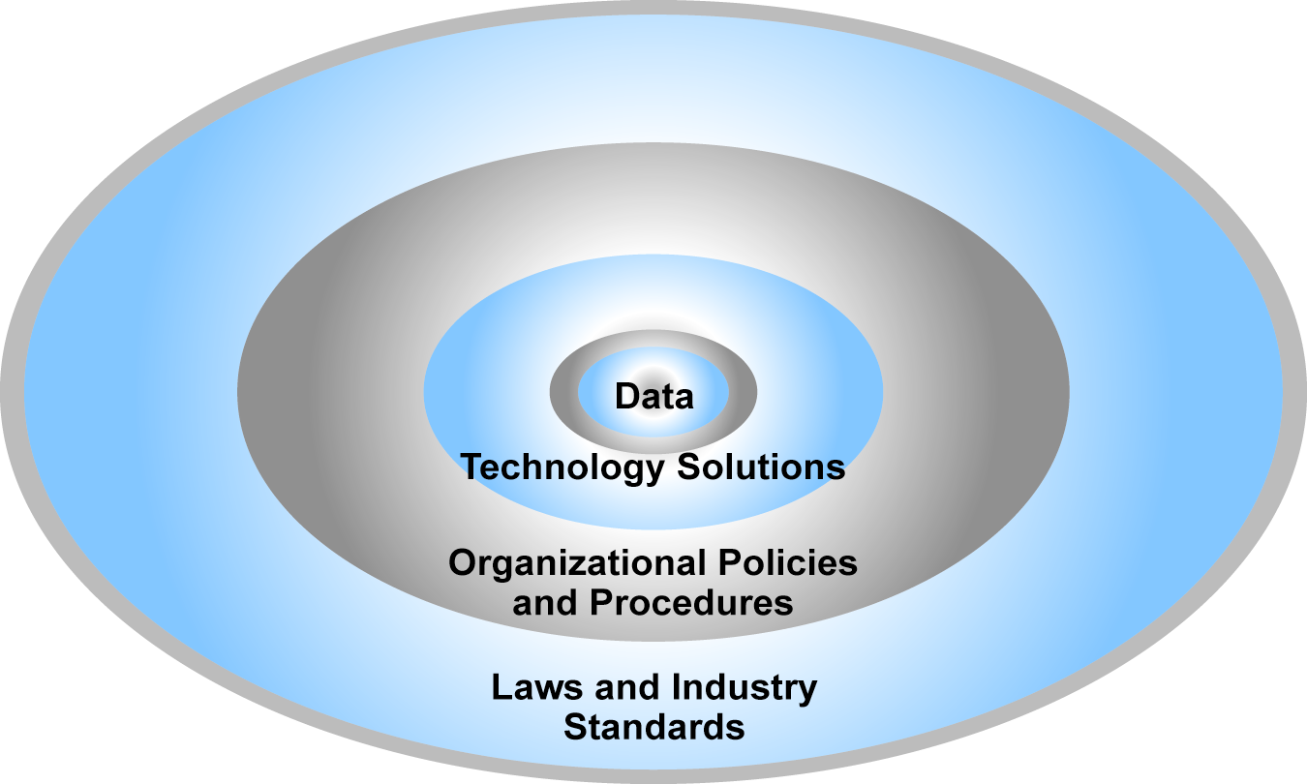
The E-commerce Security Environment

Slide 7
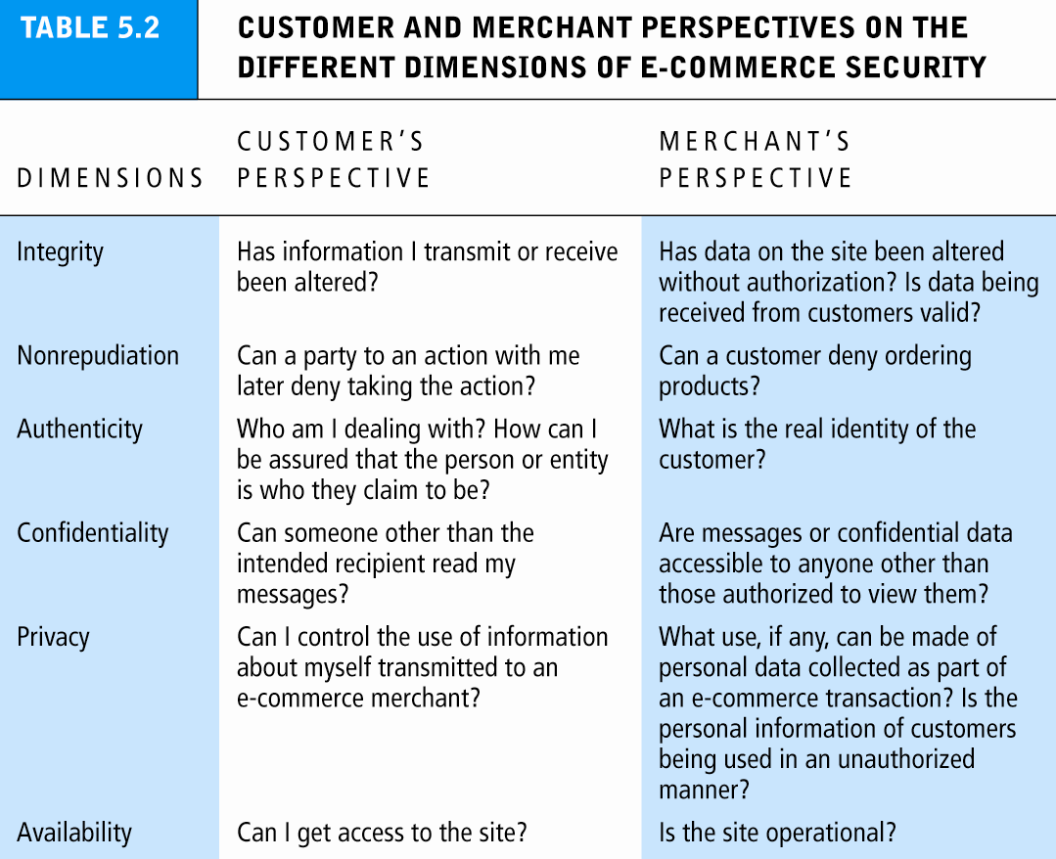

Slide 8
The Tension Between Security and Other Values
Ease of use:
  The more security measures added, the more difficult a site is to use, and the slower it becomes
Public safety and criminal uses of the Internet
  Use of technology by criminals to plan crimes or threaten nation-state

Slide 9
Security Threats in the E-commerce Environment
Three key points of vulnerability:
  Internet communications channels
  Server level
  Client level

Slide 10
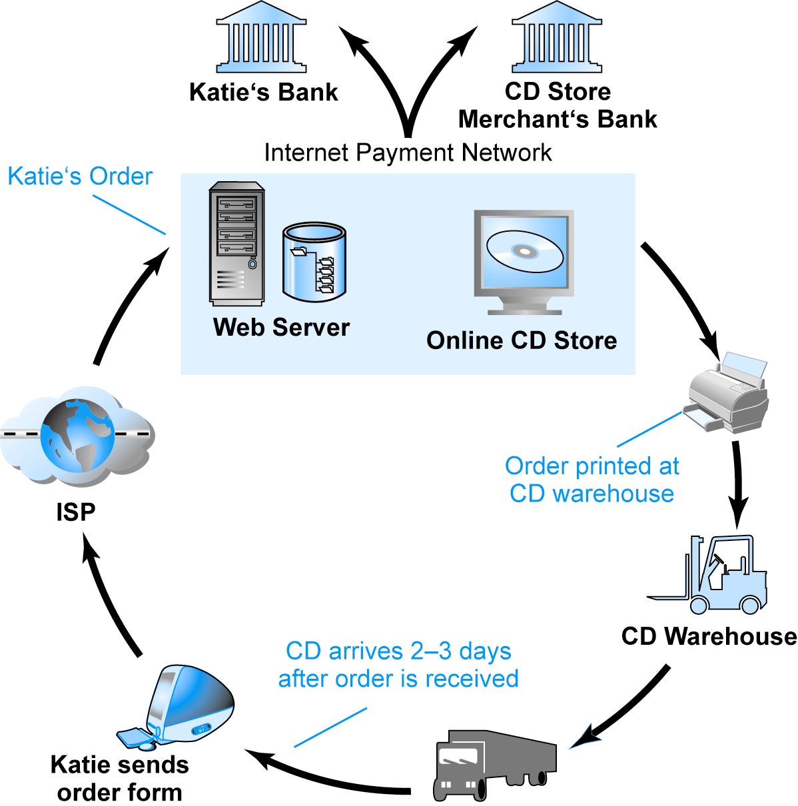
A Typical
E-commerce Transaction
SOURCE: Boncella, 2000.
Figure 4.3

Slide 11
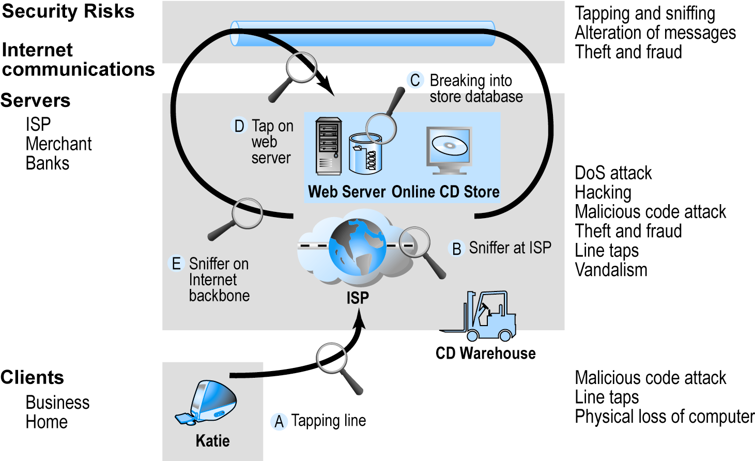
Vulnerable Points in an
E-commerce Environment
SOURCE: Boncella, 2000.

Slide 12
Most Common Security Threats in the
E-commerce Environment
Malicious code
  Viruses
  Worms
  Trojan horses
  Bots, botnets
Unwanted programs
  Browser parasites
  Adware
  Spyware

Slide 13
Most Common Security Threats (cont.)
Phishing
  Deceptive online attempt to obtain confidential information
  Social engineering, e-mail scams, spoofing legitimate Web sites
  Use of information to commit fraudulent acts (access checking accounts), steal identity
Hacking and cybervandalism
  Hackers vs. crackers
  Cybervandalism: Intentionally disrupting, defacing, destroying Web site
  Types of hackers: White hats, black hats, grey hats

Slide 14
Most Common Security Threats (cont.)
Credit card fraud/theft
  Hackers target merchant servers; use data to establish credit under false identity
Spoofing
Pharming
Spam/junk Web sites
Denial of service (DoS) attack
  Hackers flood site with useless traffic to overwhelm network
  Distributed denial of service (DDoS) attack

Slide 15
Most Common Security Threats (cont.)
Sniffing
  Eavesdropping program that monitors information traveling over a network
Insider jobs
  Single largest financial threat
Poorly designed server and client software
Mobile platform threats
  Same risks as any Internet device
  Malware, botnets, vishing/smishing

Slide 16
Technology Solutions
Protecting Internet communications (encryption)
Securing channels of communication (SSL, S-HTTP, VPNs)
Protecting networks (firewalls)
Protecting servers and clients

Slide 17
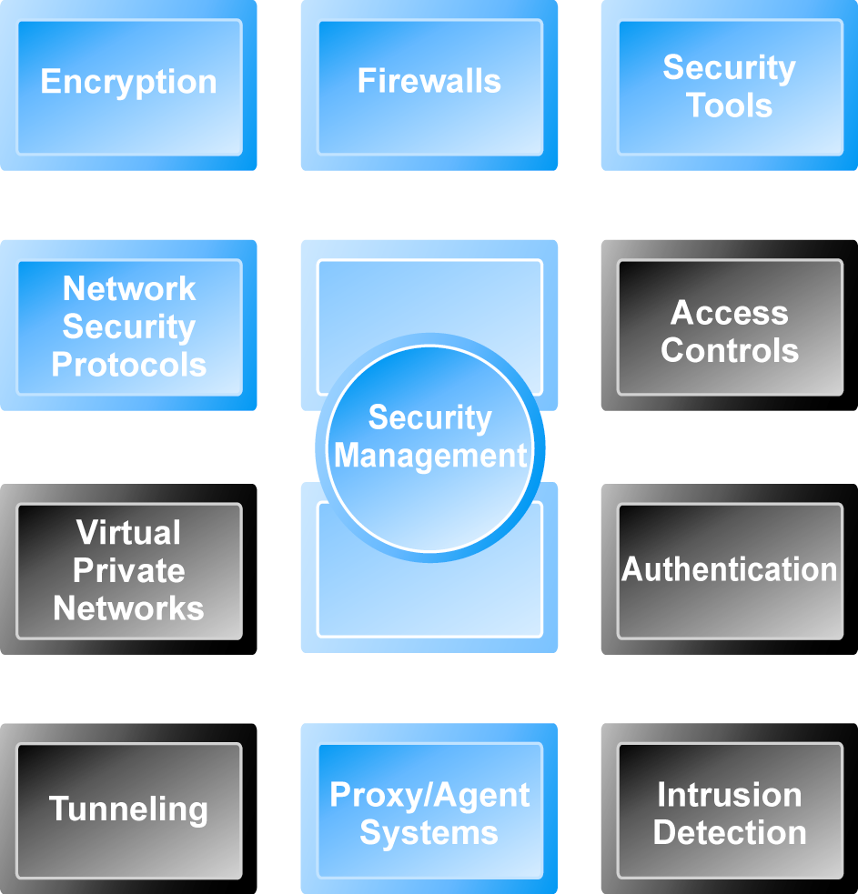
Tools Available to Achieve Site Security

Slide 18
Encryption
Encryption
  Transforms data into cipher text readable only by sender and receiver
  Secures stored information and information transmission
  Provides 4 of 6 key dimensions of e-commerce security:
    Message integrity
    Nonrepudiation
    Authentication
    Confidentiality

Slide 19
Symmetric Key Encryption
Sender and receiver use same digital key to encrypt and decrypt message
Requires different set of keys for each transaction
Strength of encryption
  Length of binary key used to encrypt data
Advanced Encryption Standard (AES)
  Most widely used symmetric key encryption
  Uses 128-, 192-, and 256-bit encryption keys
Other standards use keys with up to 2,048 bits

Slide 20
Public Key Encryption
Uses two mathematically related digital keys
  Public key (widely disseminated)
  Private key (kept secret by owner)
Both keys used to encrypt and decrypt message
Once key used to encrypt message, same key cannot be used to decrypt message
Sender uses recipient’s public key to encrypt message; recipient uses his/her private key to decrypt it

Slide 21
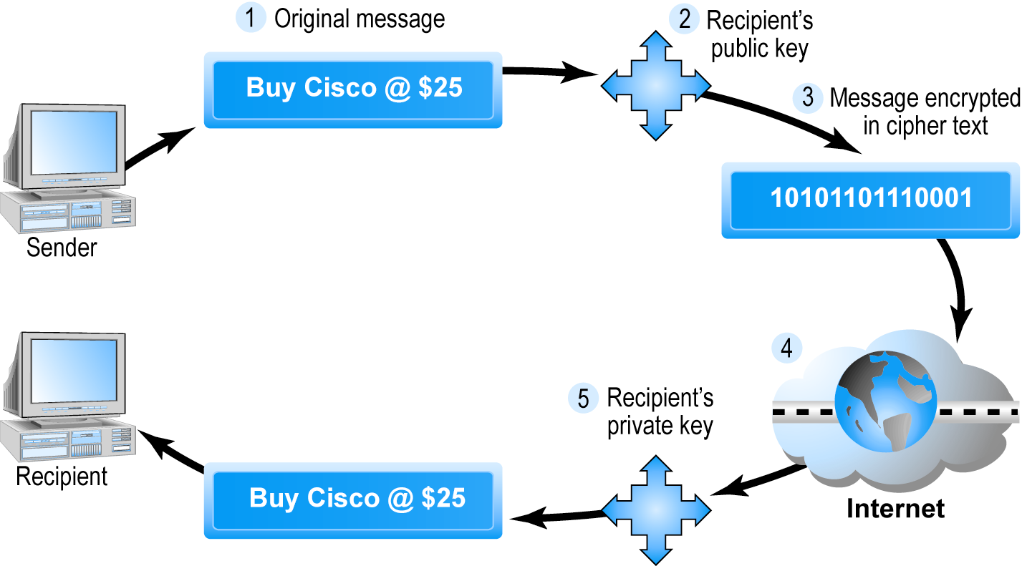
Public Key Cryptography – A Simple Case

Slide 22
Public Key Encryption using Digital Signatures and Hash Digests
Hash function:
  Mathematical algorithm that produces fixed-length number called message or hash digest
Hash digest of message sent to recipient along with message to verify integrity
Hash digest and message encrypted with recipient’s public key
Entire cipher text then encrypted with recipient’s private key – creating digital signature – for authenticity, nonrepudiation

Slide 23
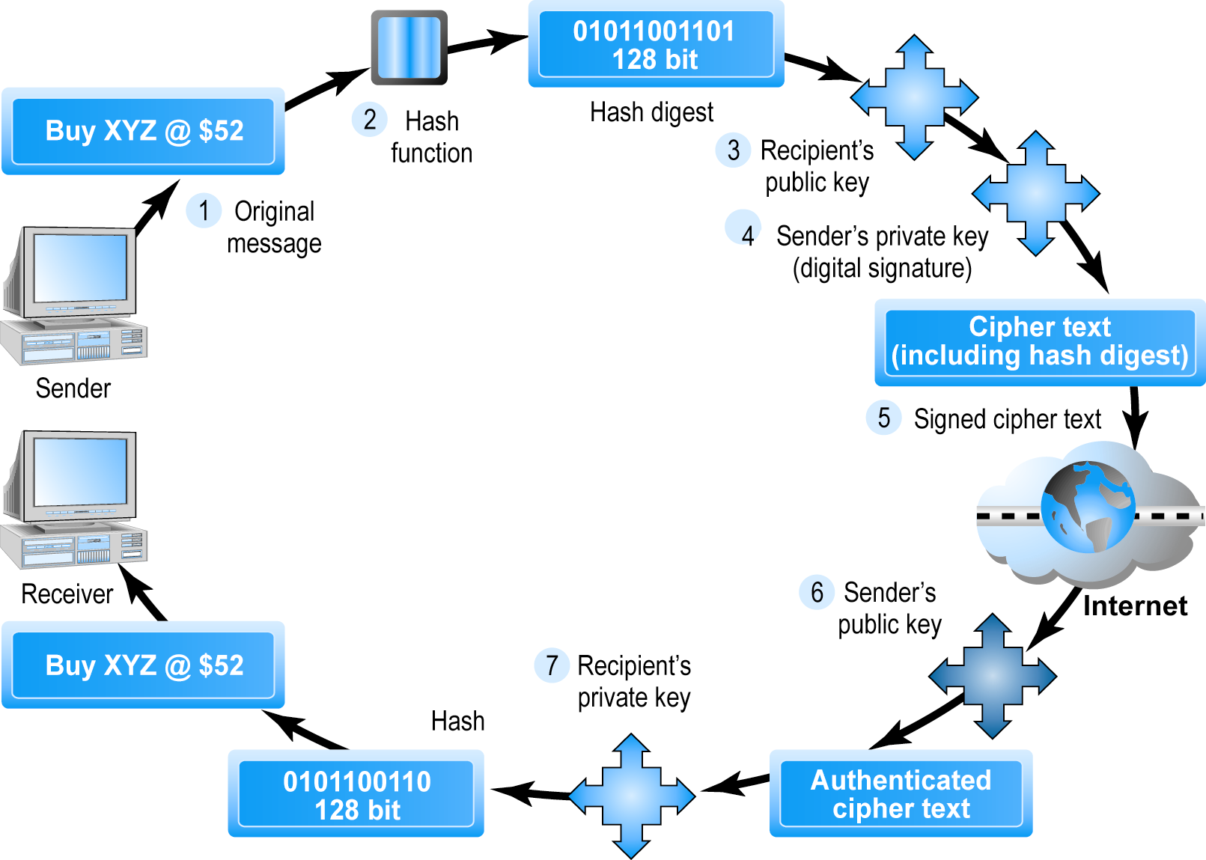
Public Key Cryptography with Digital Signatures

Slide 24
Digital Envelopes
Address weaknesses of:
  Public key encryption
    Computationally slow, decreased transmission speed, increased processing time
  Symmetric key encryption
    Insecure transmission lines
Uses symmetric key encryption to encrypt document
Uses public key encryption to encrypt and send symmetric key

Slide 25
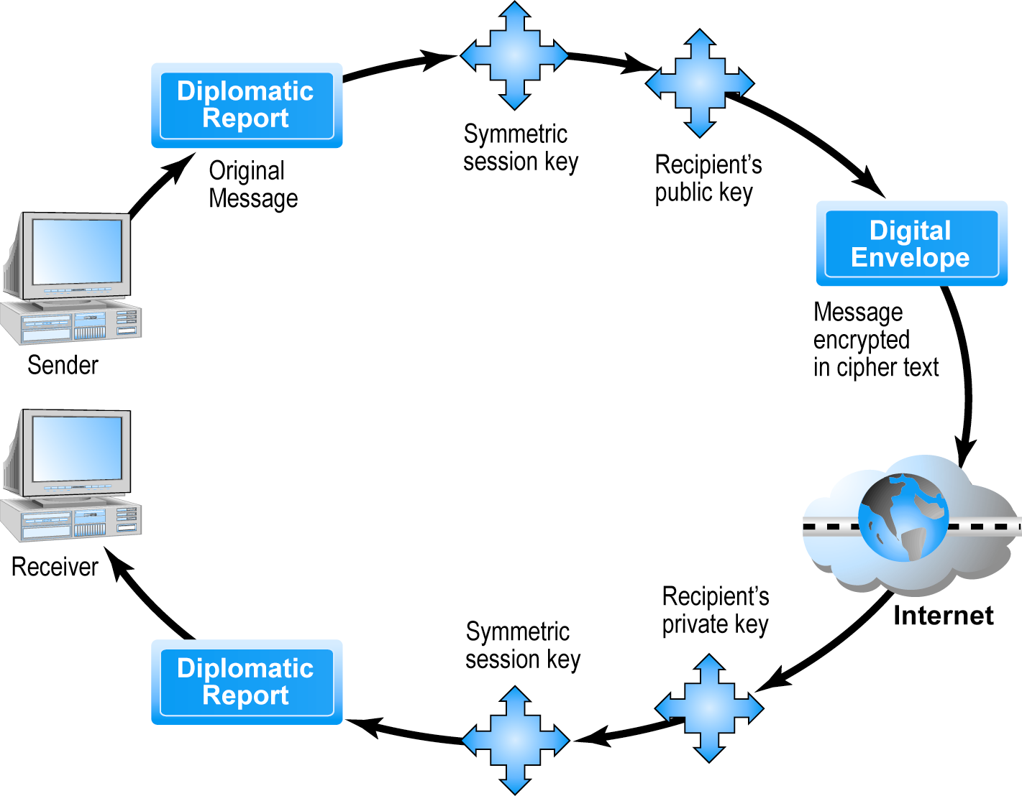
Creating a Digital Envelope

Slide 26
Digital Certificates and
Public Key Infrastructure (PKI)
Digital certificate includes:
  Name of subject/company
  Subject’s public key
  Digital certificate serial number
  Expiration date, issuance date
  Digital signature of CA
Public Key Infrastructure (PKI):
  CAs and digital certificate procedures
  PGP

Slide 27
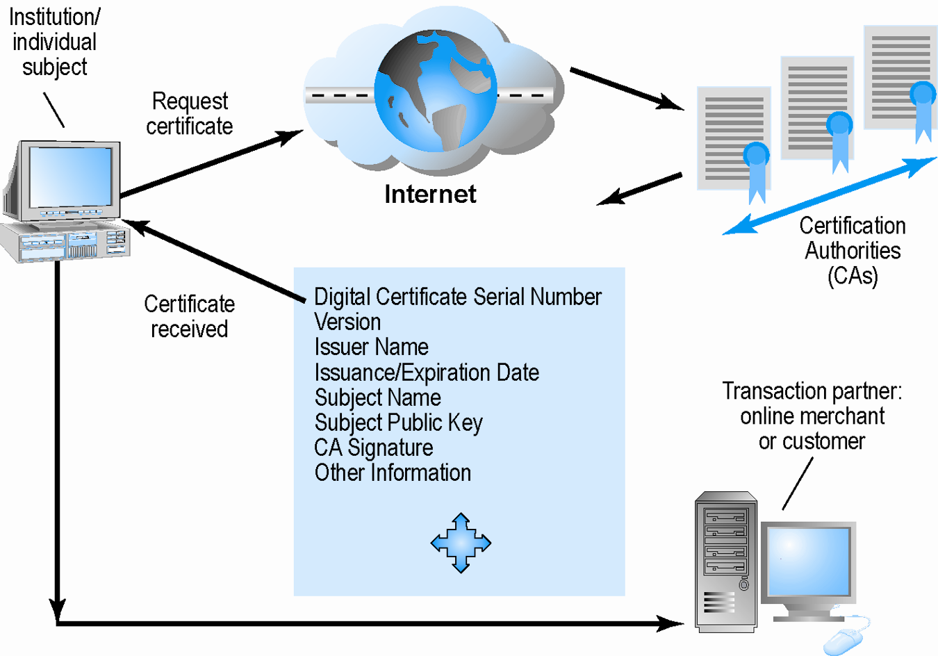
Digital Certificates and Certification Authorities

Slide 28
Limits to Encryption Solutions
Doesn’t protect storage of private key
  PKI not effective against insiders, employees
  Protection of private keys by individuals may be haphazard
No guarantee that verifying computer of merchant is secure
CAs are unregulated, self-selecting organizations

Slide 29
Insight on Society
Web Dogs and Anonymity
Class Discussion
What are some of the benefits of continuing the anonymity of the Internet?
What are the disadvantages of an identity system?
Are there advantages to an identity system beyond security?
Who should control a central identity system?

Slide 30
Securing Channels of Communication
Secure Sockets Layer (SSL):
  Establishes a secure, negotiated client-server session in which URL of requested document, along with contents, is encrypted
S-HTTP:
  Provides a secure message-oriented communications protocol designed for use in conjunction with HTTP
Virtual Private Network (VPN):
  Allows remote users to securely access internal network via the Internet, using Point-to-Point Tunneling Protocol (PPTP)

Slide 31
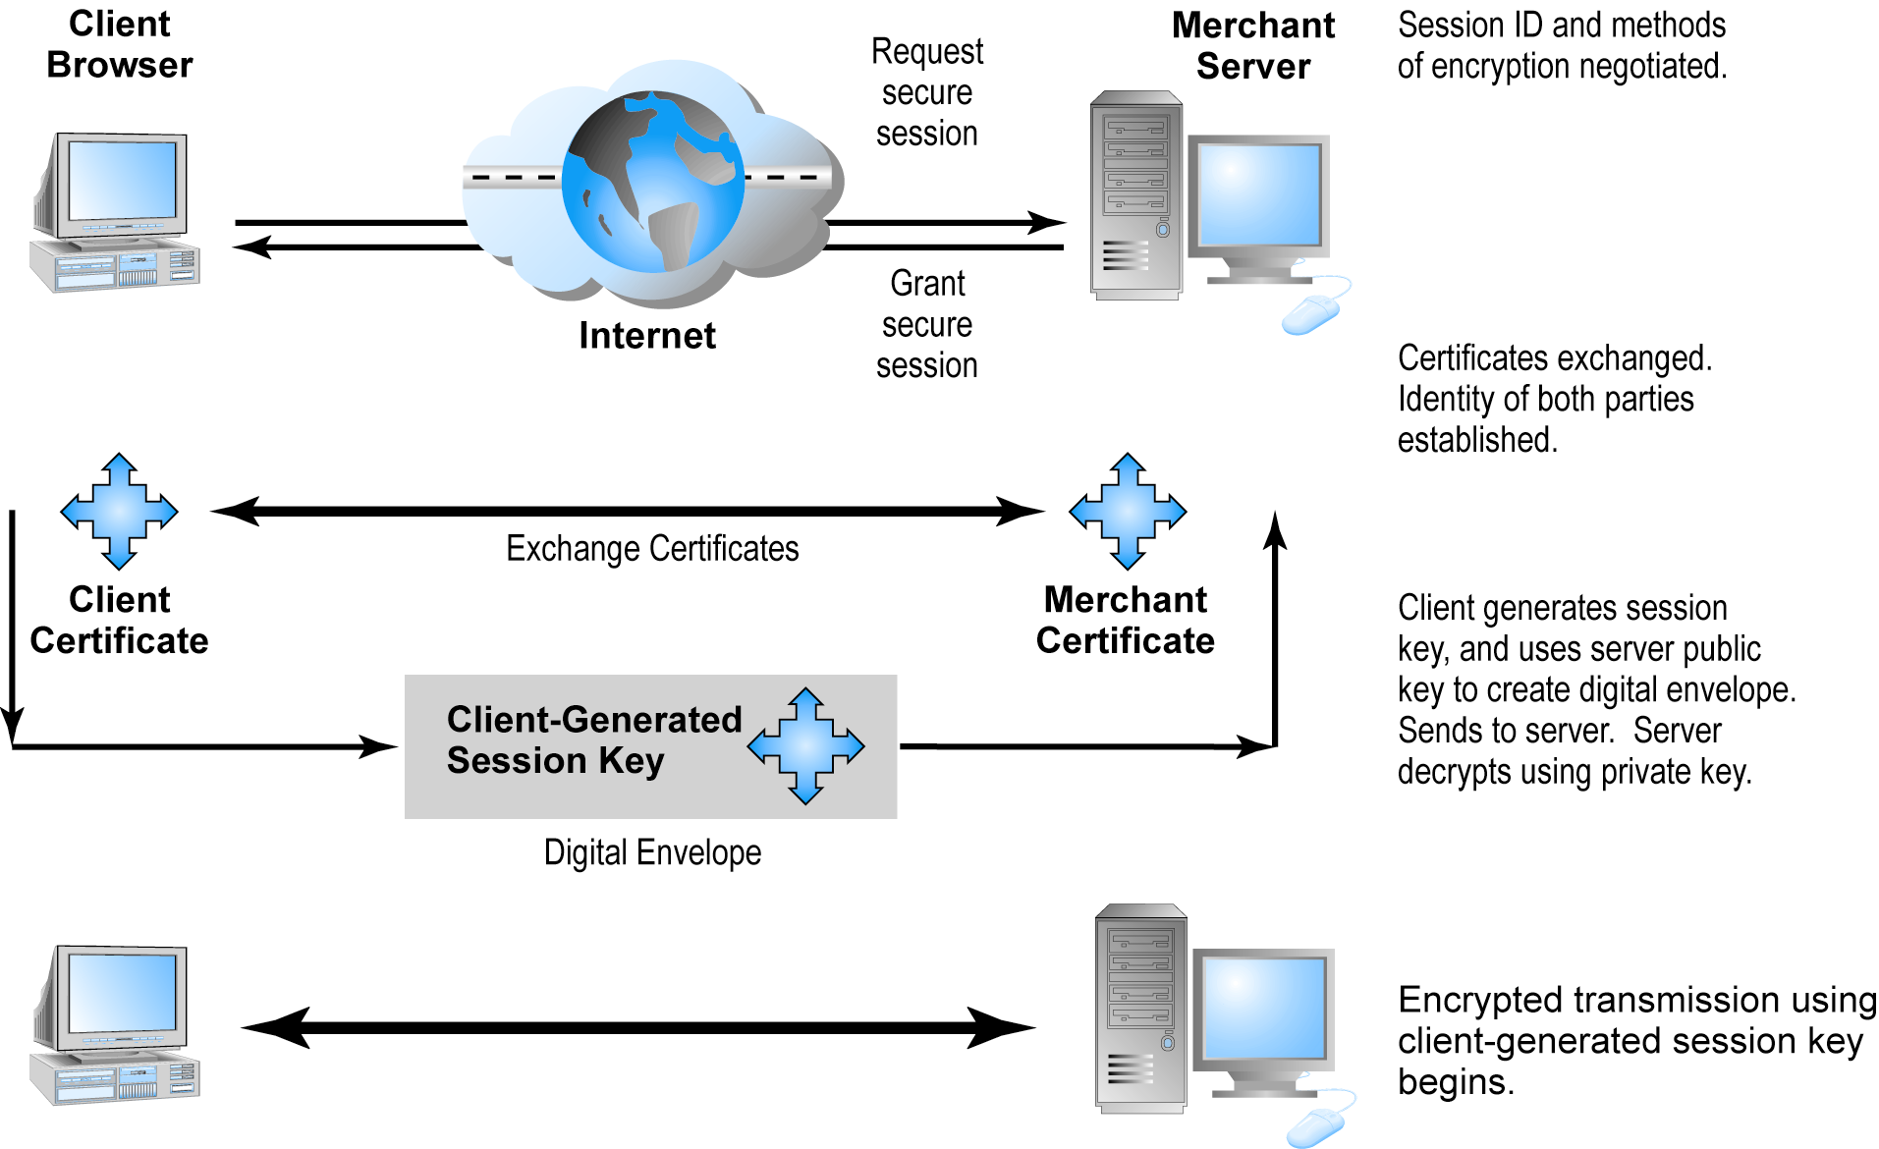
Secure Negotiated Sessions Using SSL

Slide 32
Protecting Networks
Firewall
  Hardware or software
  Uses security policy to filter packets
  Two main methods:
    Packet filters
    Application gateways
Proxy servers (proxies)
  Software servers that handle all communications originating from or being sent to the Internet

Slide 33
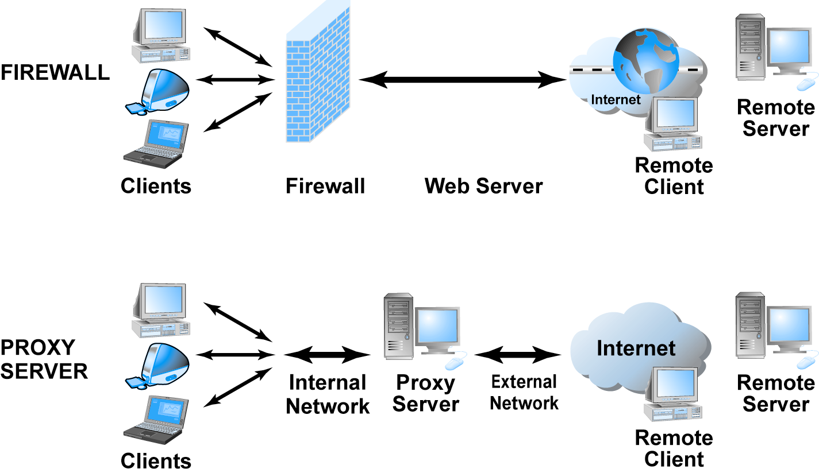
Firewalls and Proxy Servers

Slide 34
Protecting Servers and Clients
Operating system security enhancements
  Upgrades, patches
Anti-virus software:
  Easiest and least expensive way to prevent threats to system integrity
  Requires daily updates

Slide 35
Management Policies, Business Procedures, and Public Laws
U.S. firms and organizations spend 12% of IT budget on security hardware, software, services ($120 billion in 2009)
Managing risk includes
  Technology
  Effective management policies
  Public laws and active enforcement

Slide 36
A Security Plan: Management Policies
Risk assessment
Security policy
Implementation plan
  Security organization
  Access controls
  Authentication procedures, inc. biometrics
  Authorization policies, authorization management systems
Security audit

Slide 37
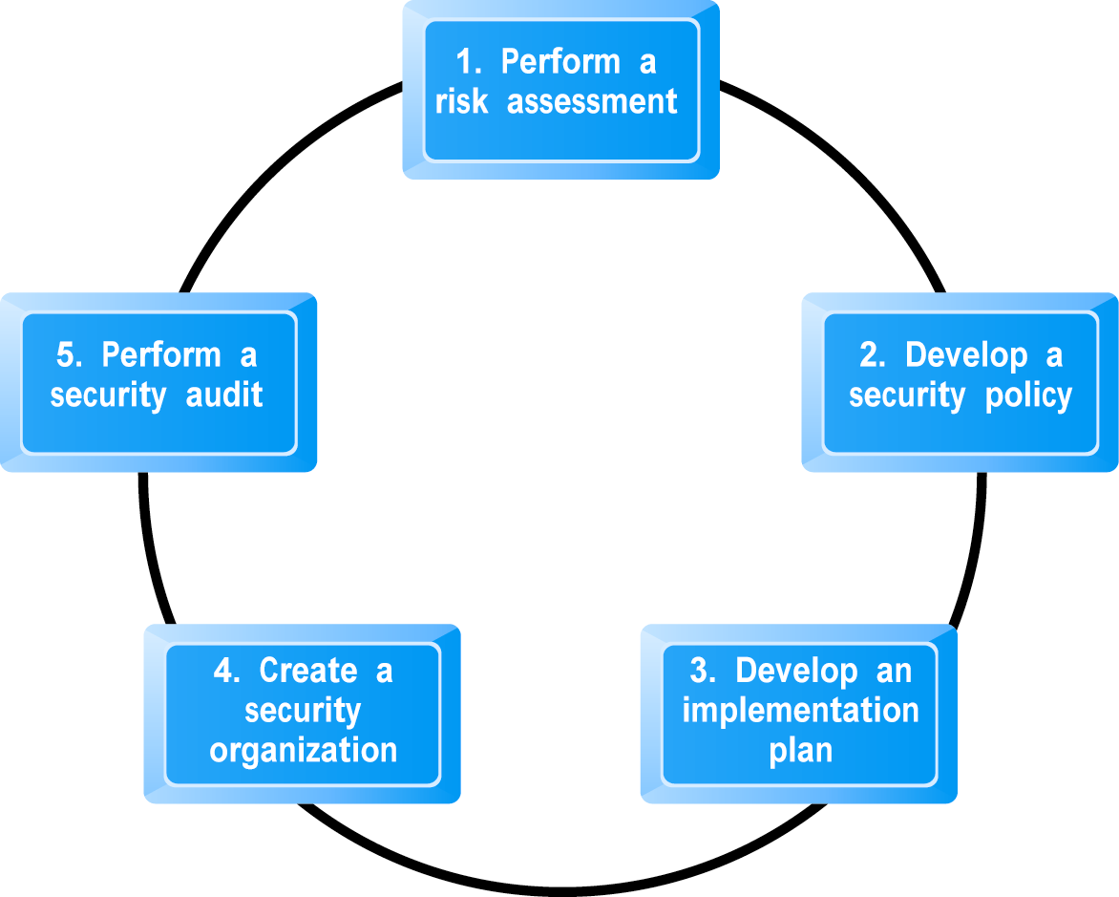
Developing an E-commerce Security Plan

Slide 38
The Role of Laws and Public Policy
Laws that give authorities tools for identifying, tracing, prosecuting cybercriminals:
  National Information Infrastructure Protection Act of 1996
  USA Patriot Act
  Homeland Security Act
Private and private-public cooperation
  CERT Coordination Center
  US-CERT
Government policies and controls on encryption software
OECD guidelines

Slide 39
Insight on Technology
Think Your Smartphone Is Secure?
Class Discussion
What types of threats do smartphones face?
Are there any particular vulnerabilities to this type of device?
What did Nicolas Seriot’s “Spyphone” prove?
Are apps more or less likely to be subject to threats than traditional PC software programs?

Slide 40
Types of Payment Systems
Cash
  Most common form of payment in terms of number of transactions
  Instantly convertible into other forms of value without intermediation
Checking Transfer
  Second most common payment form in U.S. in terms of number of transactions
Credit Card
  Credit card associations
  Issuing banks
  Processing centers

Slide 41
Types of Payment Systems (cont.)
Stored Value
  Funds deposited into account, from which funds are paid out or withdrawn as needed, e.g. debit cards, gift certificates
  Peer-to-peer payment systems
Accumulating Balance
  Accounts that accumulate expenditures and to which consumers make period payments
  e.g. Utility, phone, American Express accounts

Slide 42
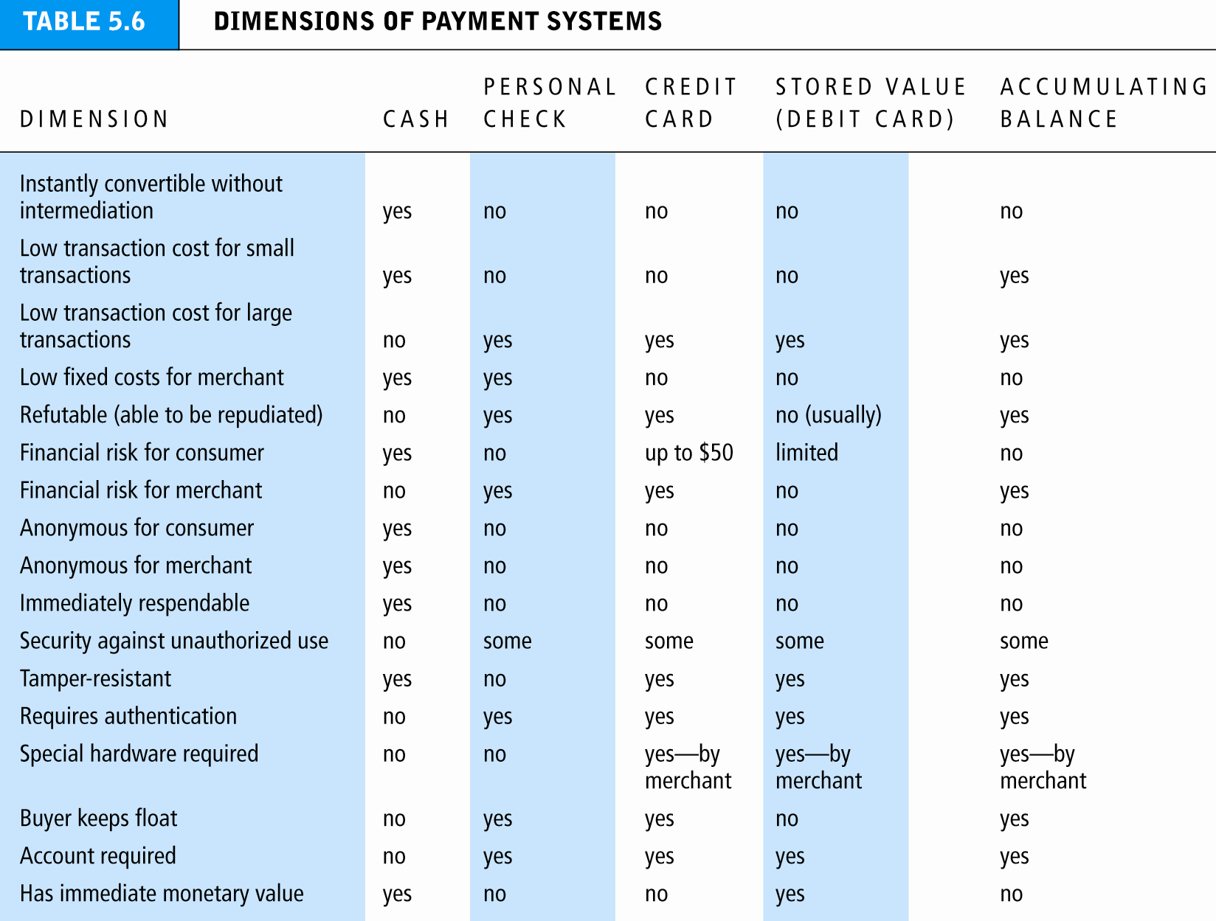

Slide 43
E-commerce Payment Systems
Credit cards
  55 % of online payments in 2009 (U.S.)
Debit cards
  28 % online payments in 2009 (U.S.)
Limitations of online credit card payment
  Security
  Cost
  Social equity

Slide 44
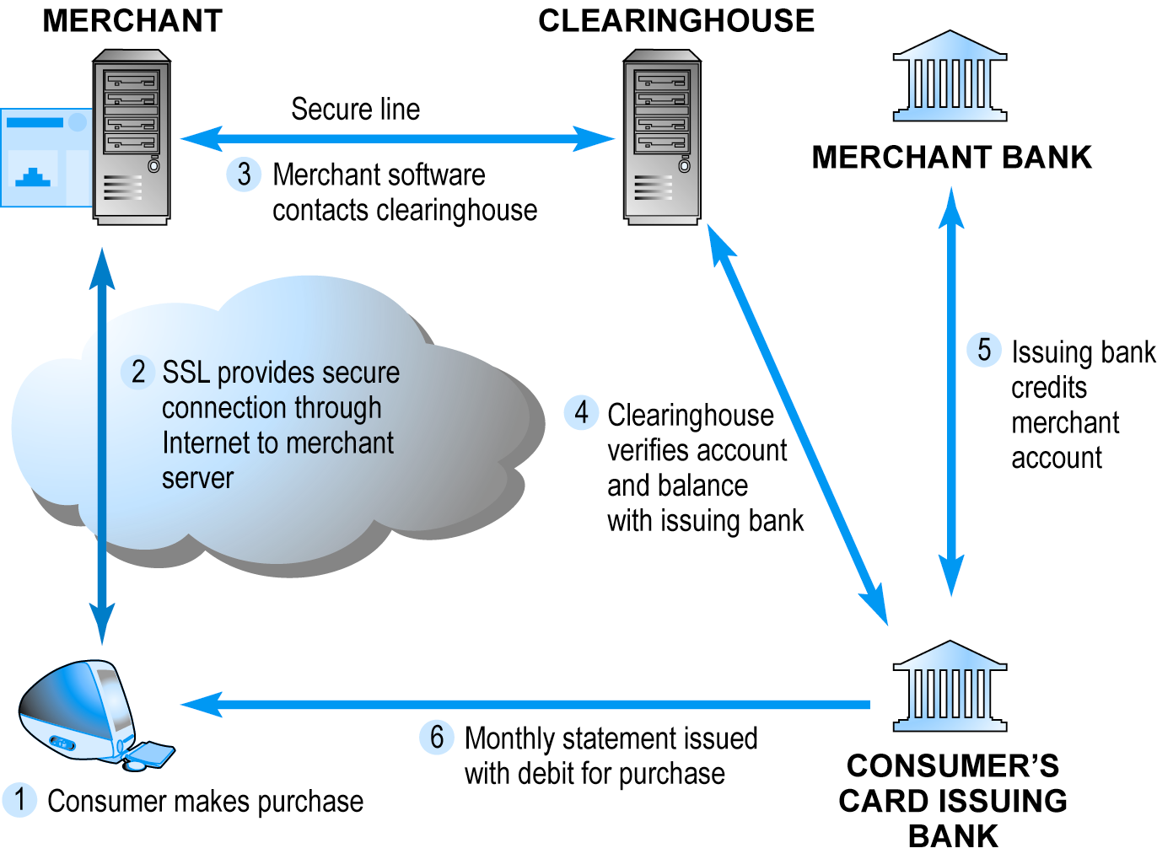
How an Online Credit Transaction Works

Slide 45
E-commerce Payment Systems (cont.)
Digital wallets
  Emulates functionality of wallet by authenticating consumer, storing and transferring value, and securing payment process from consumer to merchant
  Early efforts to popularize failed
  Newest effort: Google Checkout
Digital cash
  Value storage and exchange using tokens
  Most early examples have disappeared; protocols and practices too complex

Slide 46
E-commerce Payment Systems (cont.)
Online stored value systems
  Based on value stored in a consumer’s bank, checking, or credit card account
  PayPal, smart cards
Digital accumulated balance payment
  Users accumulate a debit balance for which they are billed at the end of the month
Digital checking:
  Extends functionality of existing checking accounts for use online

Slide 47
Mobile Payment Systems
Use of mobile handsets as payment devices well-established in Europe, Japan, South Korea
Japanese mobile payment systems
  E-money (stored value)
  Mobile debit cards
  Mobile credit cards
Not as well established yet in U.S
  Majority of purchases are digital content for use on cell phone

Slide 48
Insight on Business
Mobile Payment’s Future:
Wavepayme, Textpayme
Group Discussion
What technologies make mobile payment more feasible now than in the past?
Describe some new experiments that are helping to develop mobile payment systems.
How has PayPal responded?
Why haven’t mobile payment systems grown faster? What factors will spur their growth?

Slide 49
Electronic Billing Presentment and Payment (EBPP)
Online payment systems for monthly bills
65% + of households in 2010 used some EBPP; expected to continue to grow
Two competing EBPP business models:
  Biller-direct (dominant model)
  Consolidator
Both models are supported by EBPP infrastructure providers

